Slide 1
IBM Data Science Capstone Project
Neighbourhoods of Nairobi
William Odhiambo

Slide 2
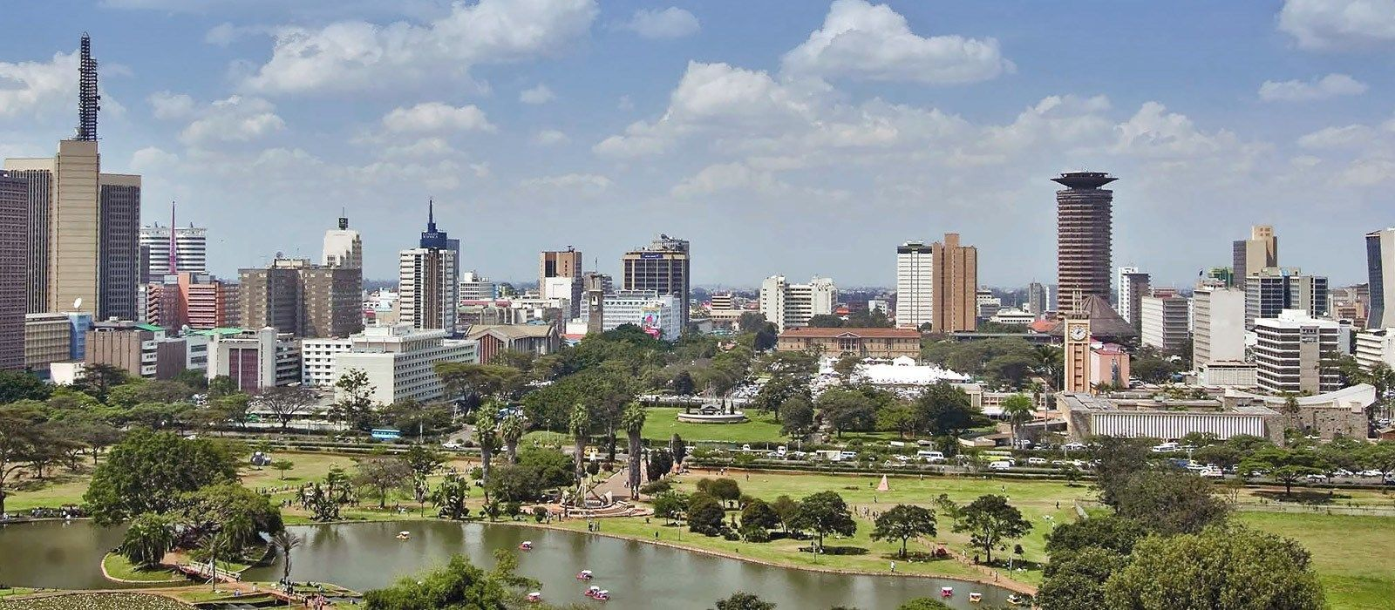
Introduction
Nairobi is the capital of Kenya, which is located in Africa. In addition to being the capital, Nairobi is also the country’s largest city by population. The last official population was taken in 2009 and at that time was 3,138,369 in the city proper. That number has since grown to approximately 3.5 million. The metro area has over 6.5 million residents. This “Green City In The Sun” has a history dating back to 1899 and continues to grow as rural residents make their way to this big city for employment opportunities.

Slide 3
Population
Nairobi's 2020 population is now estimated at 4,734,881. In 1950, the population of Nairobi was 137,456. Nairobi has grown by 821,369 since 2015, which represents a 3.88% annual change. These population estimates and projections come from the latest revision of the UN World Urbanization Prospects. These estimates represent the Urban agglomeration of Nairobi, which typically includes Nairobi's population in addition to adjacent suburban areas.
The city of Nairobi is growing consistently and currently stretches over an area of of 696 kilometers squared (269 square miles). This area size - in combination with the total number of residents - brings us the current population density which is now approximately 4,850 residents per square kilometer. (12,600 people living per square mile).

Slide 4
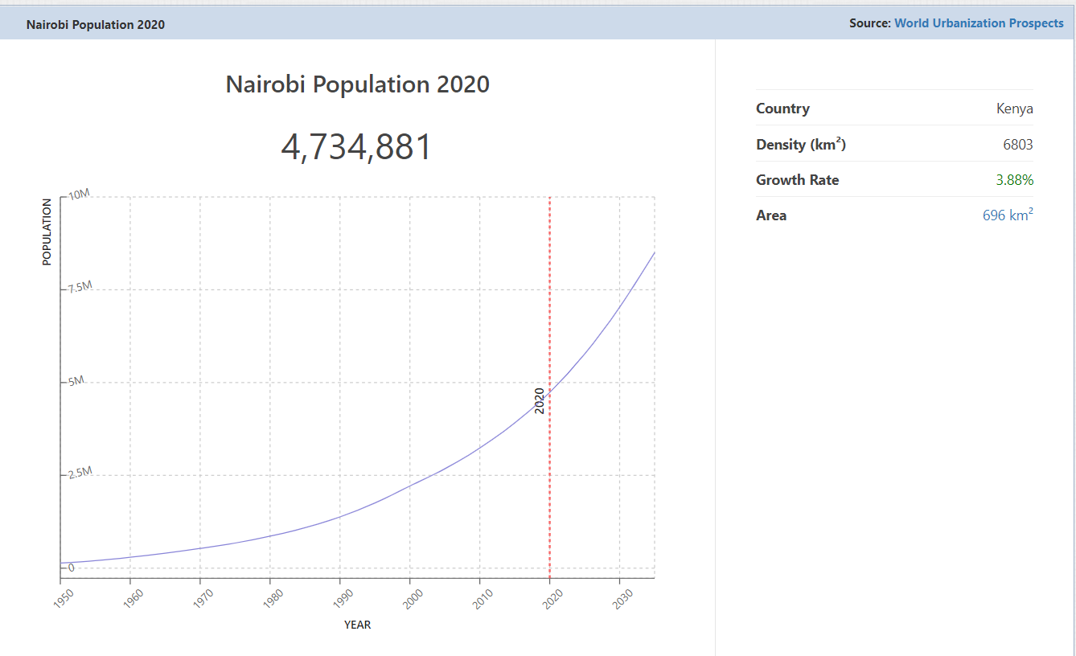

Slide 5
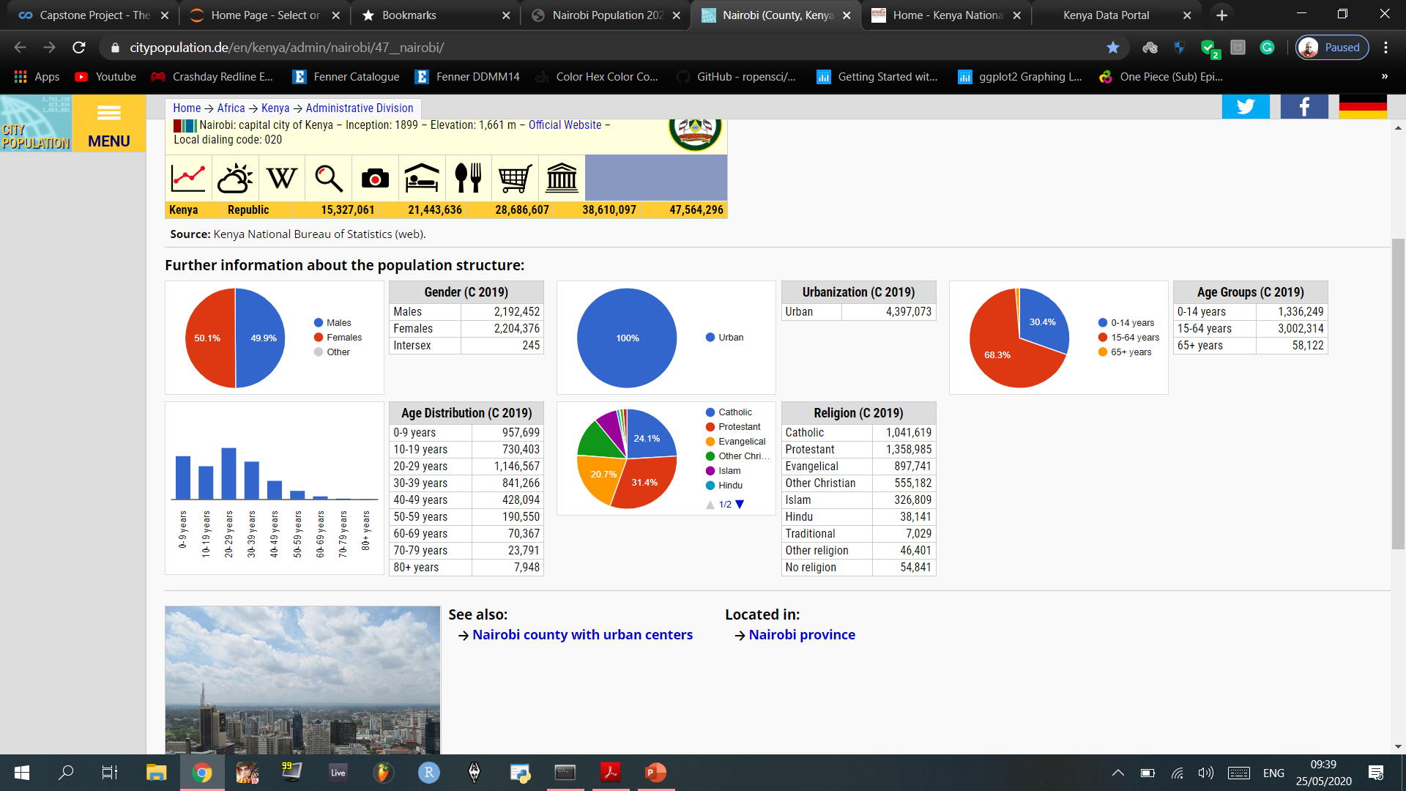
2019 Population Based on Sex, Age, and Urbanization

Slide 6
City Size and Population Density
The city of Nairobi is growing consistently and currently stretches out over a surface area of of 696 kilometers squared (269 square miles). This area size - in combination with the total number of residents - brings us the current population density which is now approximately 4,850 residents per square kilometer. (12,600 people living per square mile).

Slide 7
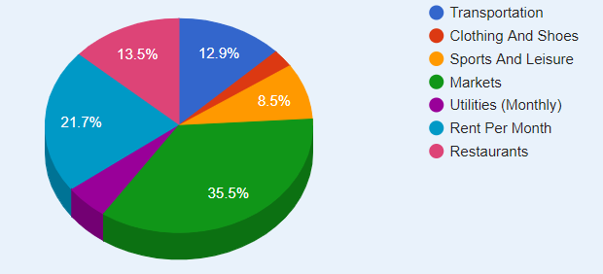
Brief Summary Of Nairobi’s Living Costs and Spending Habits
Four-person family monthly costs: (198,633.63KSh) without rent.
A single person monthly costs:(55,581.81KSh) without rent.
Cost of living rank 316th out of 488 cities in the world.
Nairobi has a cost of living index of 39.40.

Slide 8
Business Problem
Nine million individuals are expected to enter the labor force in a decade between 2015 and 2025, further pushing up the country’s unemployment rate which stood at 9.3% in 2017
According to the Kenya Economic Survey 2019, 840,600 new jobs were created in 2018 compared to 909,800 reported in 2017.
Kenya has to create at least 900,000 jobs annually between 2019 and 2025 to absorb the high number of youths joining the job market, according to the latest World Bank report
The ten year World Bank survey projects unemployment rate in Kenya was to rise to 10.5 per cent in 2019 before slowing to 10 per cent in 2020
The core objective is to establish businesses that will create Jobs - especially for the youth specifically in Nairobi, seeing that a large percentage of Nairobi’s population seem to be youthful. These businesses, also, need to be the type that appeal and build spending habits to customers of a young age, particularly from the teenage years to the late youth.

Slide 9
Data Collection and Pre-processing
Data of Nairobi’s Neighbourhoods was obtained/scraped from https://en.wikipedia.org/wiki/Category:Suburbs_of_Nairobi and formatted into a pandas Data Frame.
Population Information, Visualizations and CSV file was obtained from Nairobi Population 2020 (Demographics, Maps, Graphs), and Nairobi (County, Kenya) - Population Statistics, Charts, Map and Location.
Geocoding: Nominatim Geocoding service, which is built on top of OpenStreetMap data, was used to find the latitudinal and longitudinal values of Nairobi’s neighborhoods. Unfortunately, not all neighborhoods could be mapped because the process of converting their addresses to coordinates was somewhat limited by the Geocoder.
Folium: This builds on the data wrangling strengths of the Python ecosystem and the mapping strengths of the leaflet.js library. The library has a number of built-in tile sets from OpenStreetMap
Foursquare Developers Access to venue data: https://foursquare.com/

Slide 10
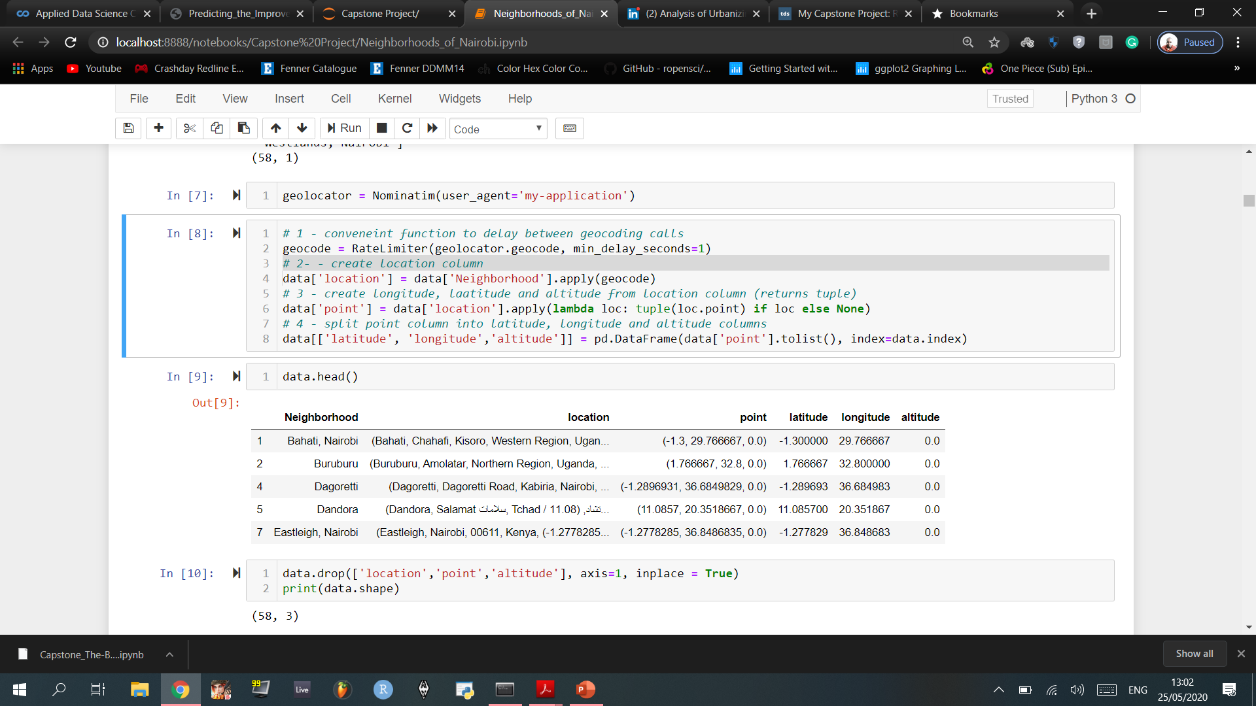
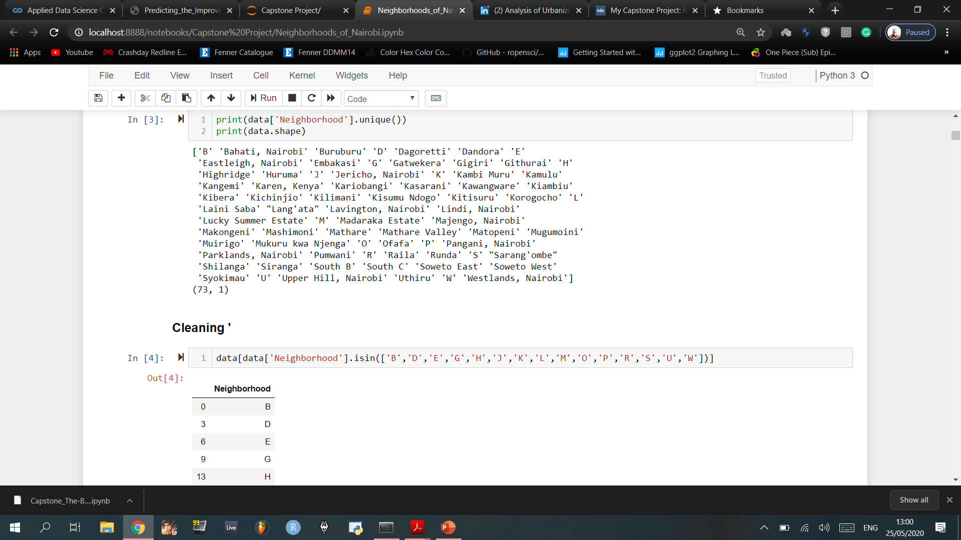
Cleaning the Neighbourhood CSV File and locating the Coordinates of Each Neighbourhood

Slide 11
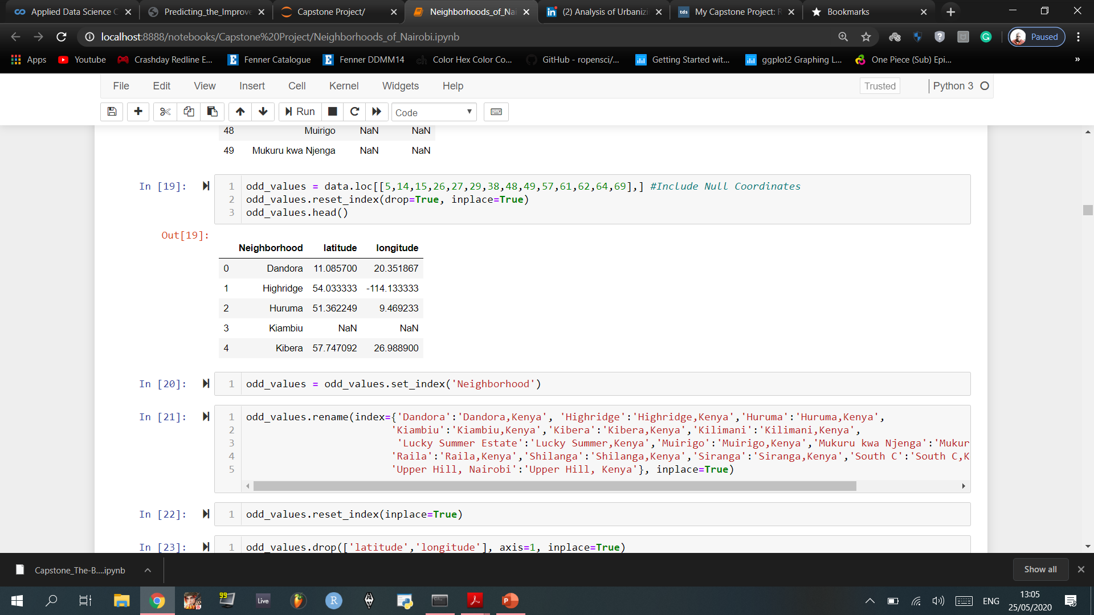
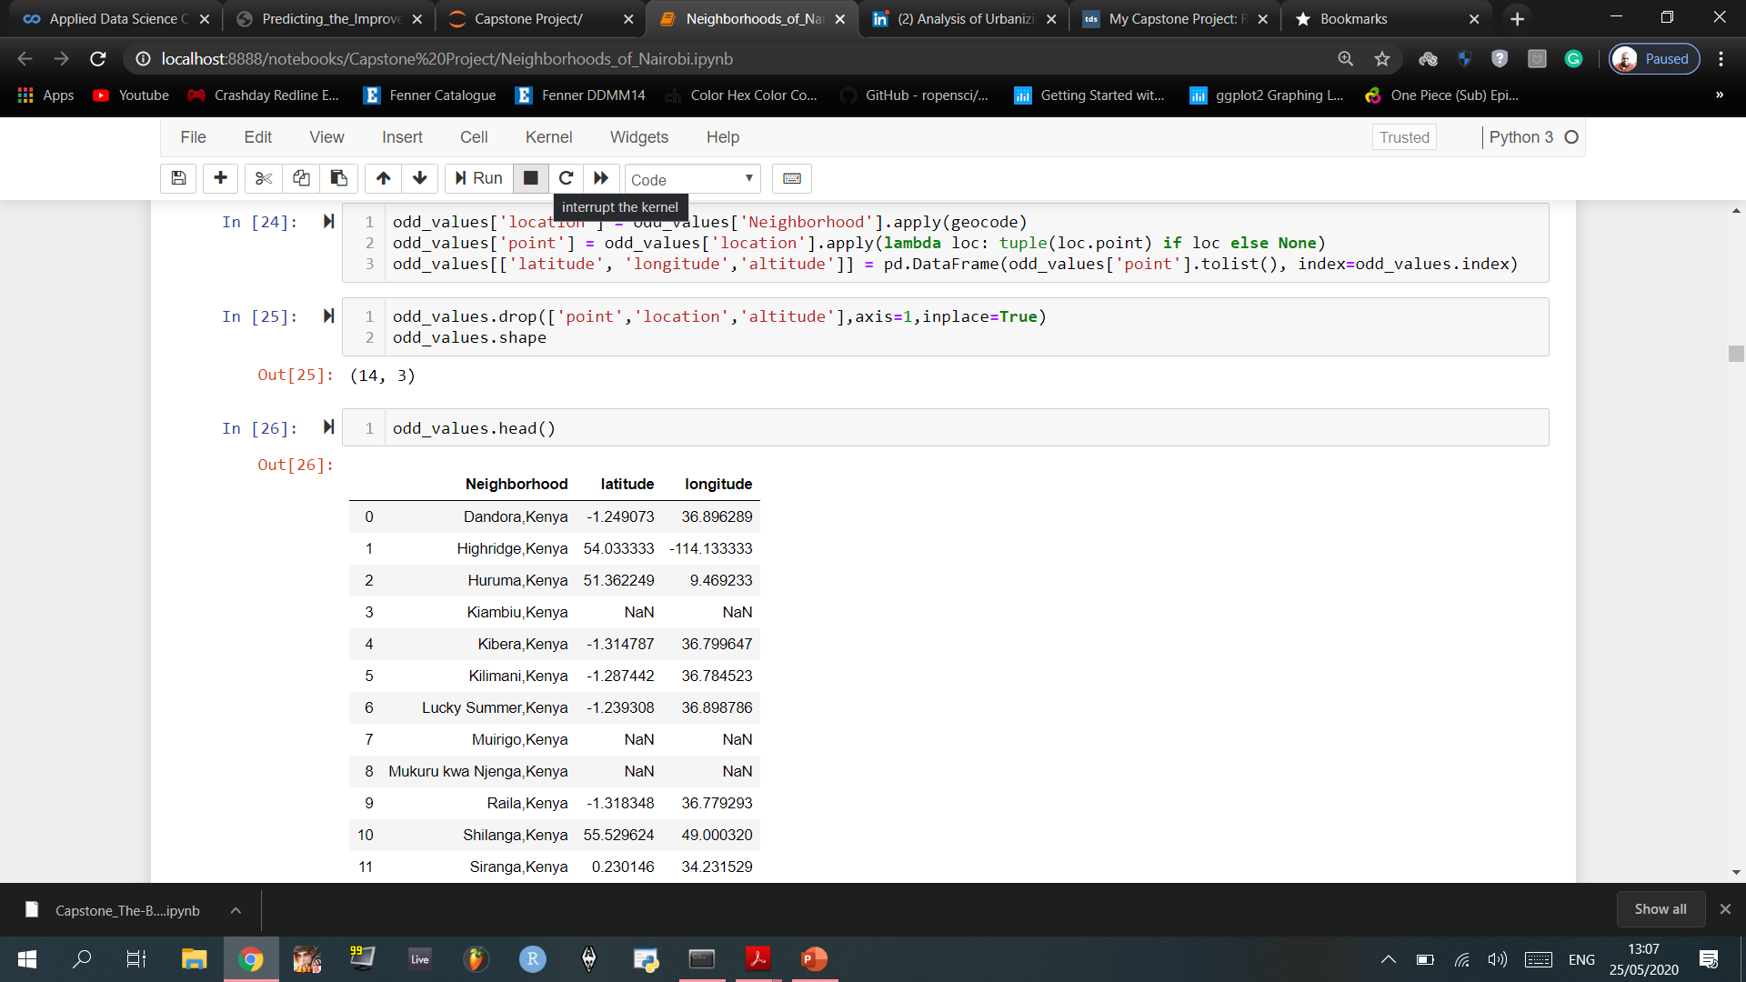
Further Cleaning of Null Values as well as latitudinal and longitudinal values that seemed to be quite off.
Cleaning of these values was done twice, where the second time was after the Neighbourhoods were renamed in order to get more accurate coordinates. This attempt was partially successful; some coordinates still had odd, and null values.

Slide 12
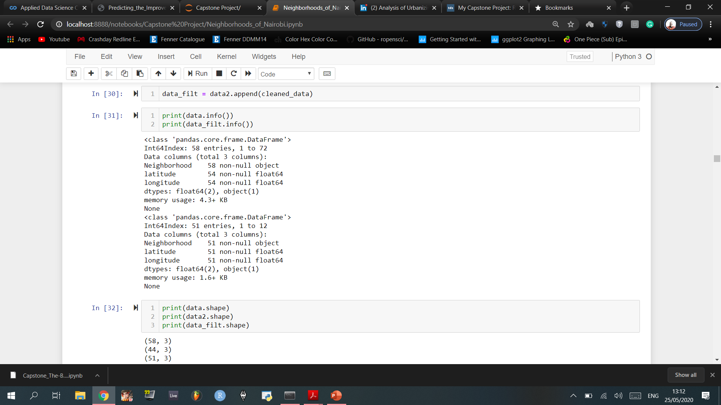
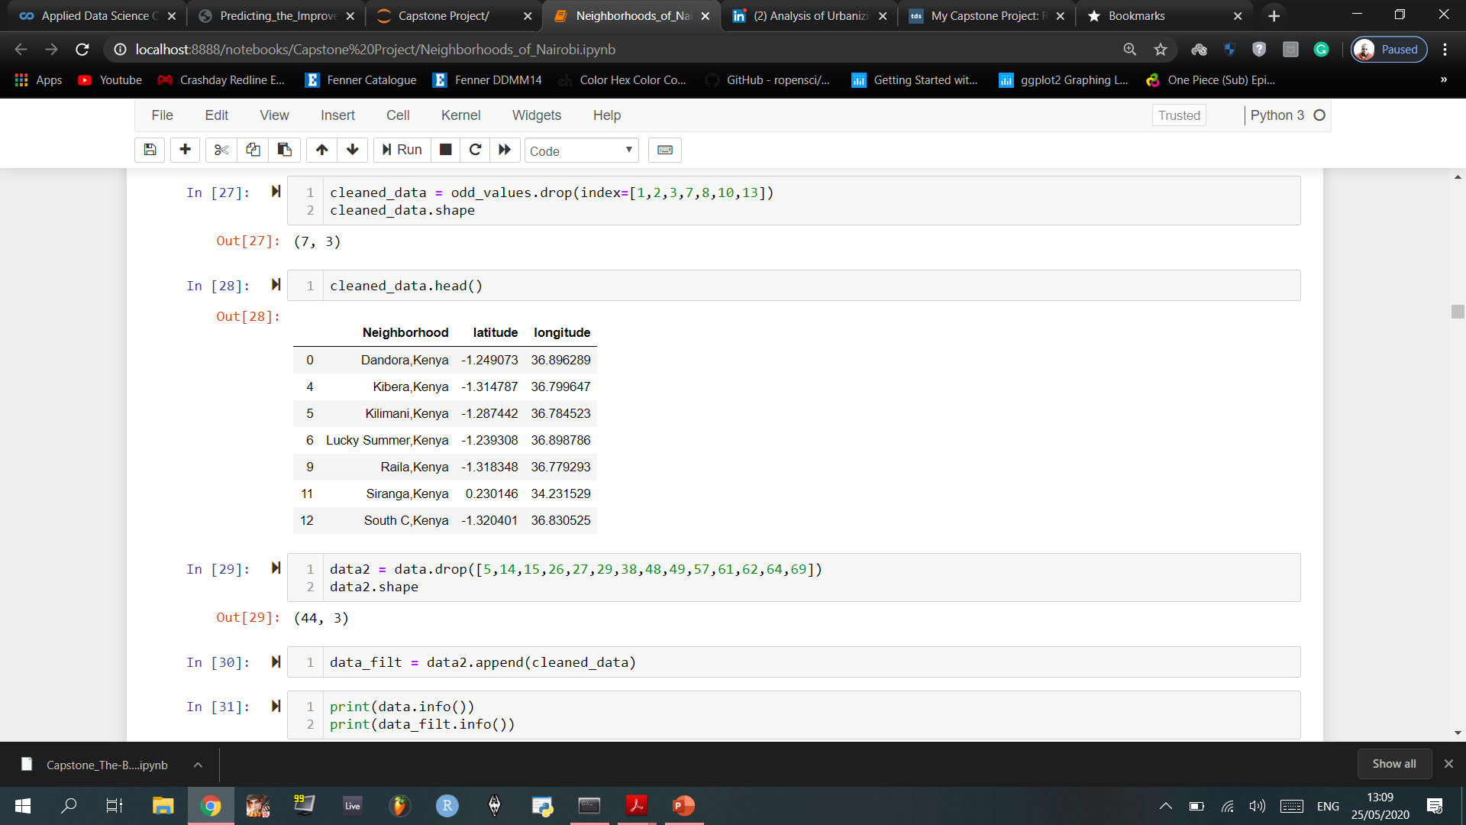
The coordinates that were successfully revalued were concatenated into the data frame that had the rest of the coordinates which had no issues.

Slide 13
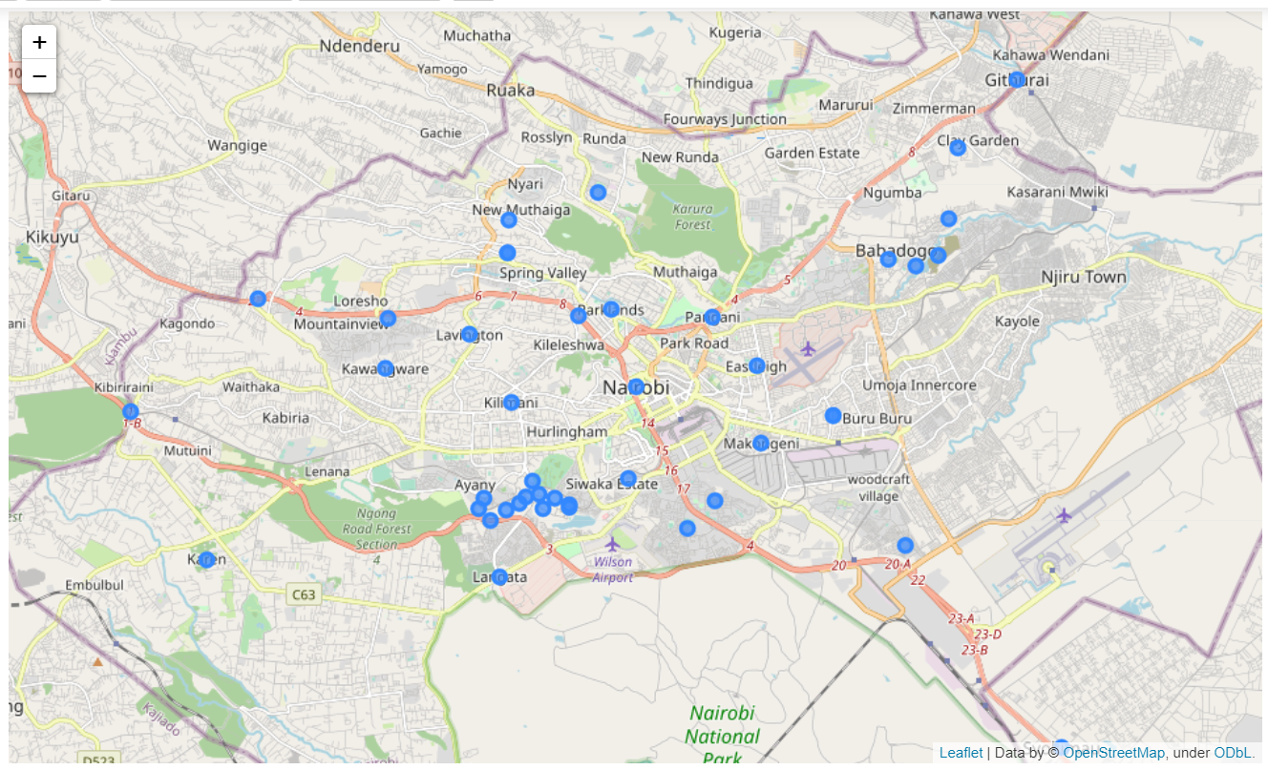
Nairobi’s Neighbourhoods (Visualized through Folium)

Slide 14
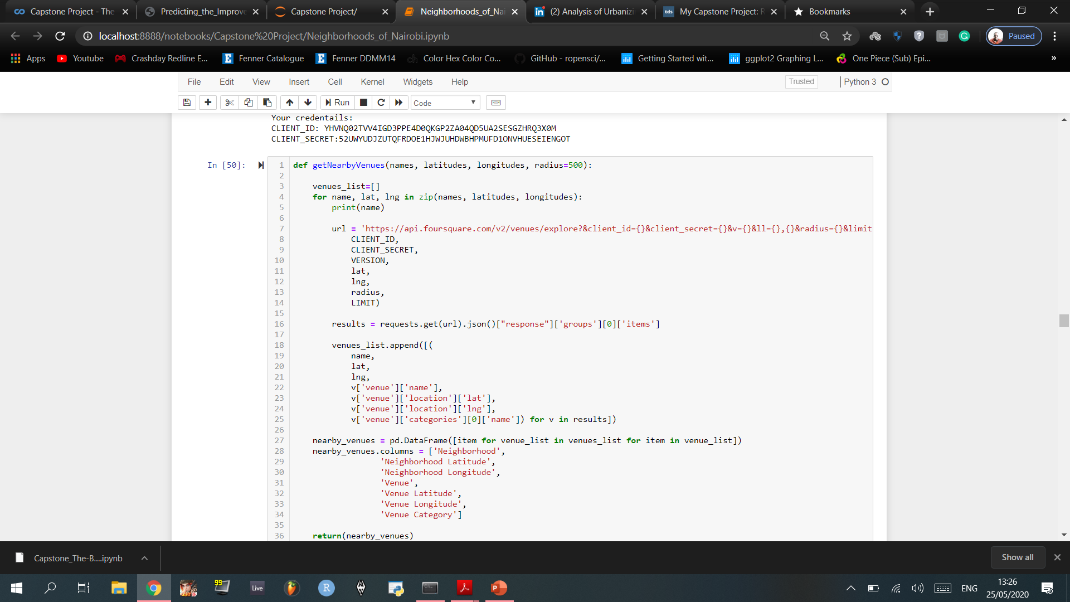
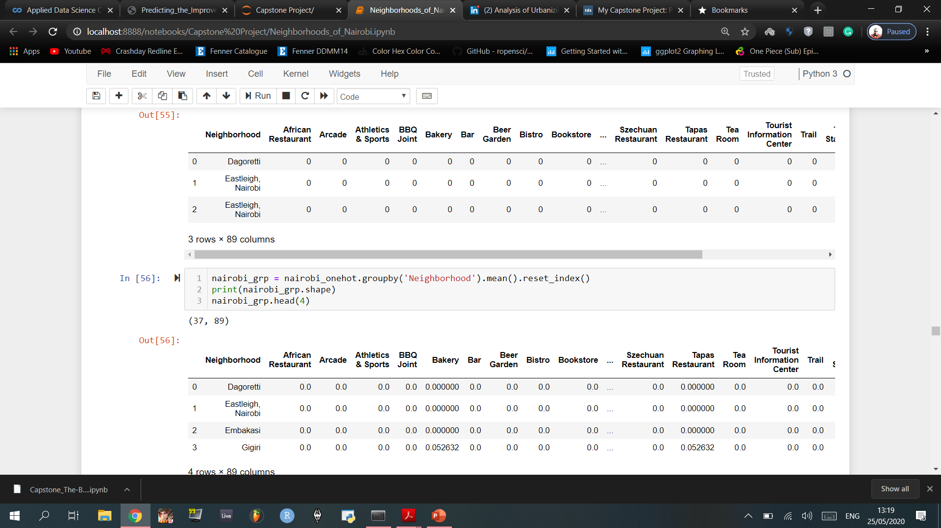
Using Foursquare’s API to determine all the neighbourhood’s nearby venues, and their coordinates, that are within a 500m range

Slide 15
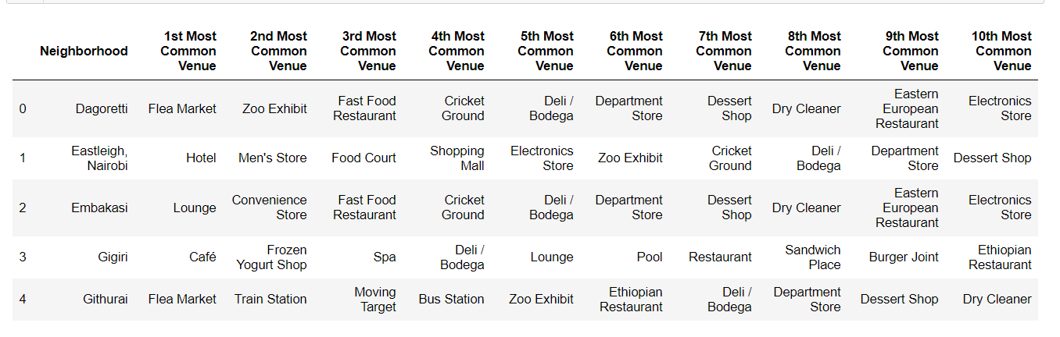
Data frame of the top Ten Most common Venues in each neighbourhood.

Slide 16
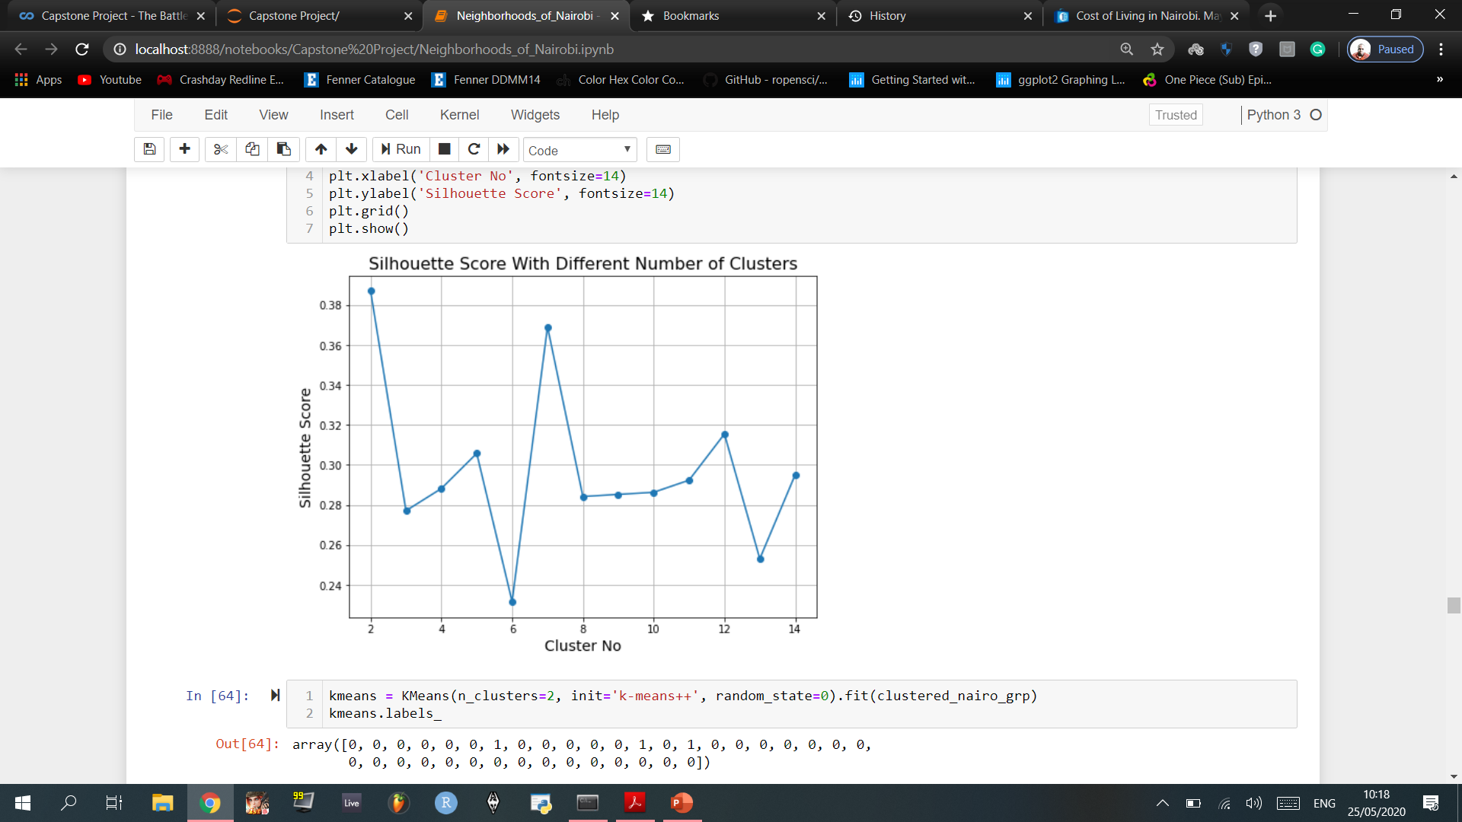
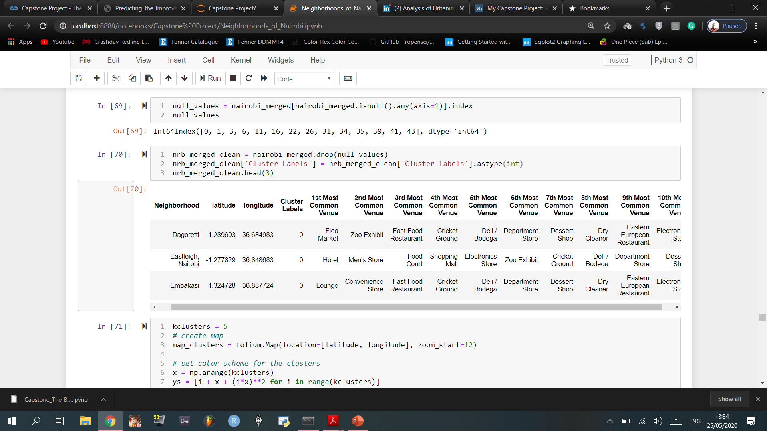
Finding the optimal number of clusters with Silhouette analysis on KMeans clustering:
The silhouette plot displays a measure of how close each point in one cluster is to points in the neighbouring clusters and thus provides a way to asses parameters like number of clusters visually. This measure has a range of (-1,1)

Slide 17
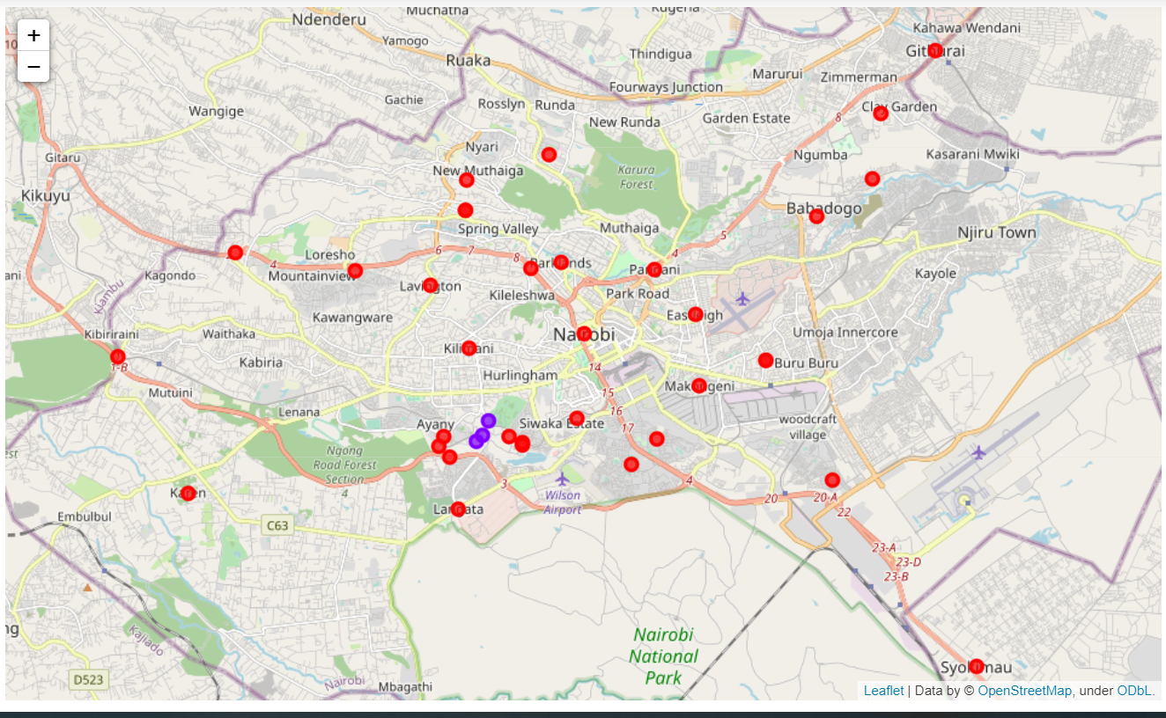
Nairobi’s (clustered) neighbourhoods visualised with Folium’s Map

Slide 18
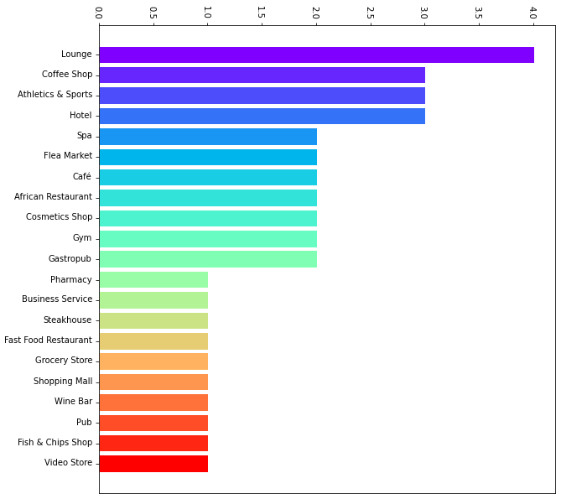
Frequency of the first most common venues in Nairobi’s neighbourhoods
Clustering Nairobi’s neighbourhoods into only 2 divisions may have been based on an optimal score, however these clusters do not seem to provide sufficient information regarding common venue data that will be needed for further analysis. An extra step had to be taken by finding venues that appear often in the 1st most common venue
The ‘Athletics & Sports’ venue is a unique case, in the sense that it all came from one labelled cluster which consisted of 3 Neighbourhoods, as shown on the previous page containing the clustered map.

Slide 19
Discussion
Source: https://kenyanwallstreet.com/census-2019-datashows-kenya-has-a-youthful-rural-population/
The conventional population of youth in Kenya aged 18 to 34 in 2019 was 13.7 million, out of which 61% were working while 1.6 million were seeking work or indicated that there was no work available. This implies youth unemployment stands at 39%
Source: https://www.ohchr.org/Documents/Issues/Youth/D_Odondi_Kenya.pdf
Leisure, recreation and community service are important for the psychological and physical development of the youth. It contributes to their personal development by promoting good health, personal discipline, leadership and team building skills. It also provides opportunity for appreciation, participation and creative experience in leisure, music, art, dance, drama crafts, novelty events service and cultural activities. This helps engaging the youth to make good use of their leisure time, express their beliefs and values as well as promote and preserve local art and culture for the benefit of the future youth. However, current investment in leisure and recreation has not reflected its importance. The sector suffers from inadequate funds and facilities while the talented youth lack motivation and are often exploited by organizations. Due to these constraints, it has not been possible to tap fully the talents of many youth.
Two specific Venues, - ‘Athletics & Sports’ and ‘Gym’ – have a summed appearance of 7 times as common venues in the 1st most common venue (from the bar chart in the previous page). However, this cannot be considered to frequent enough. There also needs to be in increment of spending habits of ‘Sports and Leisure’ which is currently standing at 8.5%

Slide 20
Conclusion
With our core objective being able to create more jobs for the youth, as well as trying to divert spending habits to the younger generation (both dependants and independent individuals), an effective way of achieving this desired goal is by creating retail business shops which sell sportswear to appeal both male and female individuals who are in their teenage years, up until those who are in their late youth.
More Gym and Fitness centres can also be developed as this will not only aid in creating jobs, but it is also a benefit to one’s health both psychologically and physically.
More Gym centres, which would result in more clients wanting to join a certain club, will therefore result in an increase in demand of consumables that aid to an individual’s fitness, e.g. Protein shakes. More retail shops can also be established in order to accommodate this demand, and thus creates more jobs.

